Slide 1


My Head Aches! A Medicine for the Toughest IP Issues in the Ever-Changing Global Economy
Prepared for ChIPs Accelerator Webinar Series
May 4, 2023
CONFIDENTIAL Attorney Work Product © 2022 Barnes & Thornburg LLP. All Rights Reserved.

Slide 2





Introductions
Today’s
Telehealth Agenda
Global IP & US Export Controls
The European Unitary Patent (UP) &
The Unified Patent Court (UPC)
Global IP Litigation
btlaw.com | 2
Notes:
Christine’s Slide

Slide 3



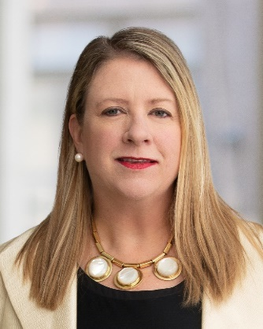
Meet Your Care Providers
Angela B. Freeman
P: 317-231-7479
E: angela.freeman@btlaw.com
Indianapolis, IN
Deborah Pollack-Milgate
P: 317-231-7339
E: deborah.pollackmilgate@btlaw.com
Indianapolis, IN
Christine Hoeft McCarthy
P: 202-317-6371
E: christine.mccarthy@btlaw.com
Washington D.C.
CONFIDENTIAL © 2023 Barnes & Thornburg LLP. All Rights Reserved. This presentation, and all information in it, is confidential, proprietary, and the property of Barnes & Thornburg LLP, which may not be disseminated or disclosed to any person or entity other than the intended recipient(s), and may not be reproduced, in any form, without the express written consent of the author or presenter. The information in this presentation is intended for informational purposes only and shall not be construed as legal advice or a legal opinion of Barnes & Thornburg.
btlaw.com | 3

Slide 4


Fictitious ACME Company: American Chemistry, Mining & Energy
  Corporate Headquarters in Chicago Since 1930’s
  Business Divisions, Subsidiaries & Affiliated Companies Around the World
  R&D Centers: US, Germany, China, India & UK
  Corporate Structure: Complex With Some Commercial Sectors Organized Under ACME Name and Sharing Legal and R&D Personnel and Processes, While Others Have Completely Different Branding and Stand-alone Business Support Platforms
CONFIDENTIAL © 2023 Barnes & Thornburg LLP. All Rights Reserved. This presentation, and all information in it, is confidential, proprietary, and the property of Barnes & Thornburg LLP, which may not be disseminated or disclosed to any person or entity other than the intended recipient(s), and may not be reproduced, in any form, without the express written consent of the author or presenter. The information in this presentation is intended for informational purposes only and shall not be construed as legal advice or a legal opinion of Barnes & Thornburg.
btlaw.com | 4

Slide 5

Global IP & US Export Controls
US Export Controls:
  Why We Care When We Share
Global Reality: Innovation & Inspiration:
  Like Viruses, Technology Innovation & Collaboration Often Don’t Pay Attention to Boarder Crossings
Where to Start:
  Let’s Talk About Pain Management
50+
practice areas
800+
legal professionals
AmLaw 100
law firm
CONFIDENTIAL © 2023 Barnes & Thornburg LLP. All Rights Reserved. This presentation, and all information in it, is confidential, proprietary, and the property of Barnes & Thornburg LLP, which may not be disseminated or disclosed to any person or entity other than the intended recipient(s), and may not be reproduced, in any form, without the express written consent of the author or presenter. The information in this presentation is intended for informational purposes only and shall not be construed as legal advice or a legal opinion of Barnes & Thornburg.
btlaw.com | 5
Notes:
Christine’s Slide

Slide 6

US Export Controls: Care When You Share
Restricts Export or Re-export of Goods, Services and Technology to: Protect US National Security, Implement Foreign Policy, e.g., Maintaining Regional Stability, and Prevent Proliferation of Weapons of Mass Destruction
U.S. Companies, Facilities and Individuals May:
  Need a License or Other Authorization Prior to Releasing Controlled US Origin Technology to Foreign Persons Outside US, Including Intra-Company Releases
  Need a License or Other Authorization for Non-US Nationals in the US to Access Controlled US Origin Technology
  Be Restricted From Dealing w/ Other Non-US Parties in a Proposed Transaction
  Be Prohibited From Involvement in Transactions in Certain Countries
  Be Prohibited From Complying with Boycott Terms in Middle Eastern Contracts
CONFIDENTIAL © 2023 Barnes & Thornburg LLP. All Rights Reserved. This presentation, and all information in it, is confidential, proprietary, and the property of Barnes & Thornburg LLP, which may not be disseminated or disclosed to any person or entity other than the intended recipient(s), and may not be reproduced, in any form, without the express written consent of the author or presenter. The information in this presentation is intended for informational purposes only and shall not be construed as legal advice or a legal opinion of Barnes & Thornburg.
btlaw.com | 6
Notes:
Angela’s Slide

Slide 7
US Export Controls: Care When You Share
Export Administration Regulations (EAR) 15 CFR Parts 730-774
  Controls Export & Re-export of: Commercial Items & “Dual-use” Products – Items that Can Be Used for Commercial or Military Purposes, i.e., Certain High-speed Computers or Industrial Machinery
  Commerce Control List (CCL) Specifies Commodities, Technology, & Software Controlled by the EAR (identified by an Export Classification Control Number (ECCN))
  Licensing Handled by Bureau of Industry and Security (BIS) of the Department of Commerce
Export Control Also Includes International Traffic in Arms Regulations (ITAR) (22 CFR Ch. 1 – Part 120 et seq.)
CONFIDENTIAL © 2023 Barnes & Thornburg LLP. All Rights Reserved. This presentation, and all information in it, is confidential, proprietary, and the property of Barnes & Thornburg LLP, which may not be disseminated or disclosed to any person or entity other than the intended recipient(s), and may not be reproduced, in any form, without the express written consent of the author or presenter. The information in this presentation is intended for informational purposes only and shall not be construed as legal advice or a legal opinion of Barnes & Thornburg.
btlaw.com | 7
Notes:
Angela’s Slide

Slide 8
US Export Controls: Care When You Share
US Government Can Impose Monetary Penalties and Individual Employees May Be Subject to Imprisonment
  Penalties Affecting a Company’s Ability to Do Business:
    Administrative Penalties
      Suspension or Denial of Export Privileges
      Debarment from US Government Contracts
  Monetary Penalties (Both Civil and Criminal) and Potential Imprisonment
CONFIDENTIAL © 2023 Barnes & Thornburg LLP. All Rights Reserved. This presentation, and all information in it, is confidential, proprietary, and the property of Barnes & Thornburg LLP, which may not be disseminated or disclosed to any person or entity other than the intended recipient(s), and may not be reproduced, in any form, without the express written consent of the author or presenter. The information in this presentation is intended for informational purposes only and shall not be construed as legal advice or a legal opinion of Barnes & Thornburg.
btlaw.com | 8
Notes:
Angela’s Slide

Slide 9
“But We Don’t Export Anything…”
What Is a Deemed Export?
  Covers Transfers of Technology Within US to a “Foreign National” (Individual Who is Not Lawfully Admitted for Permanent Residence in the US (i.e., Not a “Green Card” Holder) and is Not a Protected Individual Under the Immigration & Naturalization Act
  Applies to Transfers Under EAR and ITAR
  Export License or Other Authorization May Be Required
Global Reality of Innovation & Inspiration
50+
practice areas
800+
legal professionals
AmLaw 100
law firm
CONFIDENTIAL © 2023 Barnes & Thornburg LLP. All Rights Reserved. This presentation, and all information in it, is confidential, proprietary, and the property of Barnes & Thornburg LLP, which may not be disseminated or disclosed to any person or entity other than the intended recipient(s), and may not be reproduced, in any form, without the express written consent of the author or presenter. The information in this presentation is intended for informational purposes only and shall not be construed as legal advice or a legal opinion of Barnes & Thornburg.
btlaw.com | 9

Slide 10
Global Reality of Innovation & Inspiration
How Does a “Deemed Export” Occur?
  Release of “Technology”, “Technical Data” or Source Code to a “Foreign National”
  Visual Inspection of Equipment & Facilities
  Verbal Exchanges of Technology
  Electronic Transfers, Facsimile Transmissions
  Application to Situations Abroad of Personal Knowledge or Technical Experience Acquired in US
  Posting Regulated Technology on the Internet or a Company Intranet Accessible Outside the US
CONFIDENTIAL © 2023 Barnes & Thornburg LLP. All Rights Reserved. This presentation, and all information in it, is confidential, proprietary, and the property of Barnes & Thornburg LLP, which may not be disseminated or disclosed to any person or entity other than the intended recipient(s), and may not be reproduced, in any form, without the express written consent of the author or presenter. The information in this presentation is intended for informational purposes only and shall not be construed as legal advice or a legal opinion of Barnes & Thornburg.
btlaw.com | 10

Slide 11
Global Reality of Innovation & Inspiration
Common Scenarios
Technical Data & Technology Can be “Exported” Through: Visual Inspection, Oral Communication, or Written Communication
  Meetings With Non-US Persons Regarding US Technical Data/Technology
  Telephone Calls & Video w/ Non-US Persons
  Remote Access to Software & Technical Data on US Servers
  Emails to Non-US Persons
  Website Access
  Downloads of Technical Data/Technology From US
  Documents & Samples Hand Carried by US Travelers
  Transmission of Drawings & Specifications to Potential Foreign Vendors
Forms of Technology
Blueprints
Consulting
Technical Assistance
Instructions/Manuals
Engineering Designs
Formulae
Diagrams
Specifications
Plans
Instruction
Training
Working Knowledge
CONFIDENTIAL © 2023 Barnes & Thornburg LLP. All Rights Reserved. This presentation, and all information in it, is confidential, proprietary, and the property of Barnes & Thornburg LLP, which may not be disseminated or disclosed to any person or entity other than the intended recipient(s), and may not be reproduced, in any form, without the express written consent of the author or presenter. The information in this presentation is intended for informational purposes only and shall not be construed as legal advice or a legal opinion of Barnes & Thornburg.
btlaw.com | 11

Slide 12
Global Reality of Innovation & Inspiration
Fact: International Innovating Can Be an Export
  Discussions in US Between US and Non-US Persons
  Discussions Outside US Between US and Non-US Persons
  Joint Collaboration Between US and Non-US Personnel on New Innovations
  Evaluation by Non-US Persons of New Innovations for Patent Protection Involving US Origin Technology
  Product Manufacture With US Origin Technology or Materials Subject to US Export Control Laws
  A US Domestic Transaction If Non-US Persons are Involved
Therefore . . .
  Learn to Recognize, or Anticipate Ahead of Time, Situations that Could Cause US Export Control Problems
CONFIDENTIAL © 2023 Barnes & Thornburg LLP. All Rights Reserved. This presentation, and all information in it, is confidential, proprietary, and the property of Barnes & Thornburg LLP, which may not be disseminated or disclosed to any person or entity other than the intended recipient(s), and may not be reproduced, in any form, without the express written consent of the author or presenter. The information in this presentation is intended for informational purposes only and shall not be construed as legal advice or a legal opinion of Barnes & Thornburg.
btlaw.com | 12

Slide 13
Pain Management
Consult with Export Compliance Officer
Analyze Controls on Company’s Technology/ Technical Data
Training
Implement Export Compliance Program & Procedures for Handling Technology/Technical Data
Secure Intra-company Databases & Files
Investigate Other Countries’ Export Controls
CONFIDENTIAL © 2023 Barnes & Thornburg LLP. All Rights Reserved. This presentation, and all information in it, is confidential, proprietary, and the property of Barnes & Thornburg LLP, which may not be disseminated or disclosed to any person or entity other than the intended recipient(s), and may not be reproduced, in any form, without the express written consent of the author or presenter. The information in this presentation is intended for informational purposes only and shall not be construed as legal advice or a legal opinion of Barnes & Thornburg.
btlaw.com | 13

Slide 14
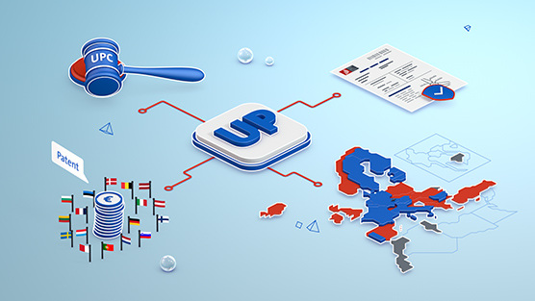
The European Unitary Patent (UP) and
The Unified Patent Court (UPC)
Overview and Timing of the new UP/UPC System:
  June 1, 2023
Coverage and Cost Considerations of a Unitary Patent
Practical Considerations whether to Opt Out of UP/UPC
  Patent Invalidation or Revocation or
  Patent Infringement
Information and Updates about the Unified Patent Court
  Courts and Judicial Personnel
CONFIDENTIAL © 2023 Barnes & Thornburg LLP. All Rights Reserved. This presentation, and all information in it, is confidential, proprietary, and the property of Barnes & Thornburg LLP, which may not be disseminated or disclosed to any person or entity other than the intended recipient(s), and may not be reproduced, in any form, without the express written consent of the author or presenter. The information in this presentation is intended for informational purposes only and shall not be construed as legal advice or a legal opinion of Barnes & Thornburg.
btlaw.com | 14

Slide 15
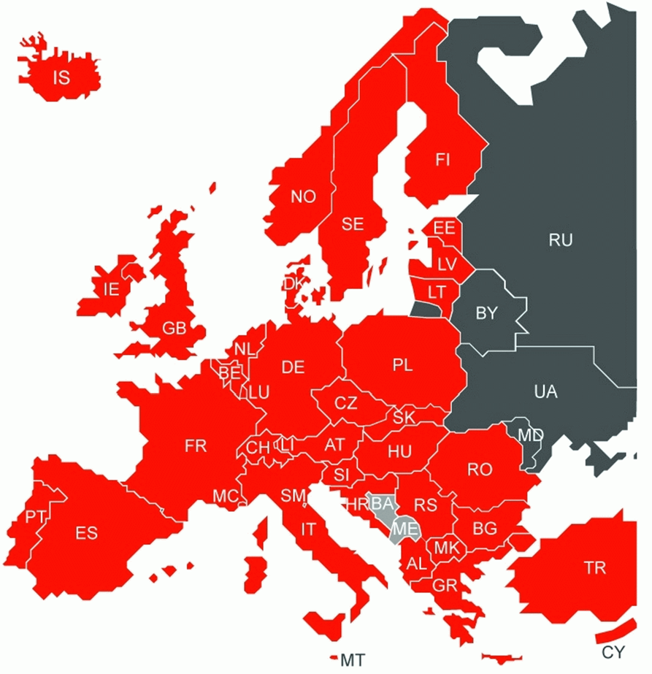


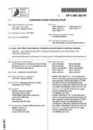






The European Unitary Patent (UP) and
The Unified Patent Court (UPC)
Current System
Incoming System
CONFIDENTIAL © 2023 Barnes & Thornburg LLP. All Rights Reserved. This presentation, and all information in it, is confidential, proprietary, and the property of Barnes & Thornburg LLP, which may not be disseminated or disclosed to any person or entity other than the intended recipient(s), and may not be reproduced, in any form, without the express written consent of the author or presenter. The information in this presentation is intended for informational purposes only and shall not be construed as legal advice or a legal opinion of Barnes & Thornburg.
btlaw.com | 15

Slide 16

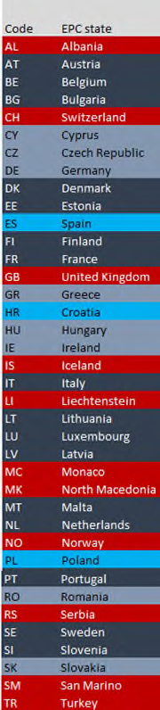
The European Unitary Patent (UP) and
The Unified Patent Court (UPC)
Non-EU EPC member states are ineligible: AL, CH, GB, IS, LI, MC, MK, NO, RS, SM, & TR.
Validation and Extension states also ineligible: MA, MD, TN, KH, BA, & ME.
EPC
EU
3 EU countries that have not signed up to UP/UPC are ineligible: ES, HR, & PL.
UPC/UP
participants
7 EU countries that have not yet ratified UPCA: CY, CZ, GR, HU, IE, RO, & SK.
UPC
Ratified
17 countries have already ratified UPCA: AT, BE, BG, DE¹, DK, EE, FI, FR, IT, LT, LU, LV, MT, NL, PT, SE, & SI.
About 24-25 EU member states may join in time.
CONFIDENTIAL © 2023 Barnes & Thornburg LLP. All Rights Reserved. This presentation, and all information in it, is confidential, proprietary, and the property of Barnes & Thornburg LLP, which may not be disseminated or disclosed to any person or entity other than the intended recipient(s), and may not be reproduced, in any form, without the express written consent of the author or presenter. The information in this presentation is intended for informational purposes only and shall not be construed as legal advice or a legal opinion of Barnes & Thornburg.
btlaw.com | 16

Slide 17
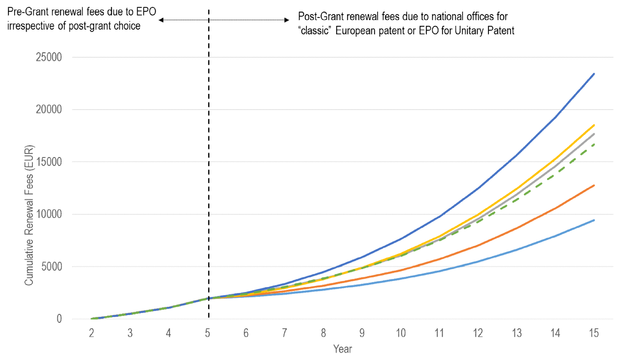
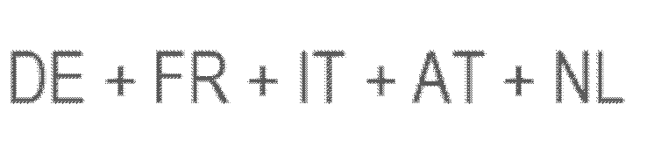
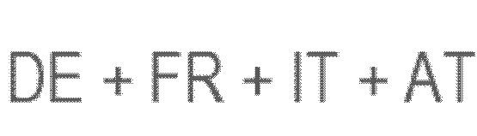


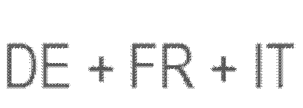

The European Unitary Patent (UP) and
The Unified Patent Court (UPC)
Coverage in 25 states over 20 years
Total renewal fees for UP totals ~35,555 EUR or ~ 39,114 USD
Total renewal fees of EP totals ~160,633 EUR or ~176,712 USD
EUR EUR
  2nd year 35 11th year 1 460
  3rd year 105 12th year 1 775
  4th year 145 13th year 2 105
  5th year 315 14th year 2 455
  6th year 475 15th year 2 830
  7th year 630 16th year 3 240
  8th year 815 17th year 3 640
  9th year 990 18th year 4 055
  10th year 1 175 19th year 4 455
  20th year 4 855
CONFIDENTIAL © 2023 Barnes & Thornburg LLP. All Rights Reserved. This presentation, and all information in it, is confidential, proprietary, and the property of Barnes & Thornburg LLP, which may not be disseminated or disclosed to any person or entity other than the intended recipient(s), and may not be reproduced, in any form, without the express written consent of the author or presenter. The information in this presentation is intended for informational purposes only and shall not be construed as legal advice or a legal opinion of Barnes & Thornburg.
btlaw.com | 17

Slide 18
National Patent Granted
EP PATENT GRANTED
EP Validation
(3 months from grant)
The European
Unitary Patent (UP)
National Patent
Validated EP Patent
Exclusive competence of the national courts
CURRENT SYSTEM
FUTURE UPC SYSTEM
National Patent Granted
EP PATENT GRANTED
For non-UP states: same as currently
For UP states: choice of UP or national EPs
UP selected?
Within 1 month from grant
NO
YES
50+
practice areas
EP Validation
(3 months from grant)
800+
legal professionals
AmLaw 100
law firm
National Patent (incl. UPC and non-UPC states)
Unitary Patent
EPC UPC
states (EPO route)
Exclusive competence of the national courts
Exclusive competence of the UPC
CONFIDENTIAL © 2023 Barnes & Thornburg LLP. All Rights Reserved. This presentation, and all information in it, is confidential, proprietary, and the property of Barnes & Thornburg LLP, which may not be disseminated or disclosed to any person or entity other than the intended recipient(s), and may not be reproduced, in any form, without the express written consent of the author or presenter. The information in this presentation is intended for informational purposes only and shall not be construed as legal advice or a legal opinion of Barnes & Thornburg.
btlaw.com | 18

Slide 19
The European
Unitary Patent (UP)
50+
practice areas
800+
legal professionals
AmLaw 100
law firm
btlaw.com | 19

Slide 20
The European
Unitary Patent (UP)
EP PATENT GRANTED
For non-UP states: same as currently
For UP states: choice of UP or national EPs
National Patent Granted
UP selected?
Within 1 month from grant
EP Validation
(3 months from grant)
NO
YES
National Patent (incl. UPC and non-UPC states)
50+
practice areas
800+
legal professionals
AmLaw 100
law firm
EPC UPC
states (EPO route)
Unitary Patent
Non-UPC
EPC states (EPO route)
“Mixed” competence – actions can be brought in UPC or national courts
Exclusive competence of the UPC
Exclusive competence of the national courts
CONFIDENTIAL © 2023 Barnes & Thornburg LLP. All Rights Reserved. This presentation, and all information in it, is confidential, proprietary, and the property of Barnes & Thornburg LLP, which may not be disseminated or disclosed to any person or entity other than the intended recipient(s), and may not be reproduced, in any form, without the express written consent of the author or presenter. The information in this presentation is intended for informational purposes only and shall not be construed as legal advice or a legal opinion of Barnes & Thornburg.
btlaw.com | 20

Slide 21
The European Unitary Patent (UP) & The Unified Patent Court (UPC)
The HARD “Headed” Decisions
Advantages:
No additional costs to register UP at EPO
Current coverage across 17 EU countries for price of
about 4 countries
Reduced costs for translations
Centralized platform for infringement actions – less costly
Judges with significant patent experience in UPC
Disadvantages:
Uncertainty and higher risk in legal outcome in UPC
Centralized platform for validity challenges & risk of central revocation of patent family in all UPC states
Higher annuity costs if more than 4 countries desired
Does not currently cover all EU member states
UP cannot be opted out of UPC jurisdiction or abandonment of single application – treated as bundle of rights that rise and fall together
CONFIDENTIAL © 2023 Barnes & Thornburg LLP. All Rights Reserved. This presentation, and all information in it, is confidential, proprietary, and the property of Barnes & Thornburg LLP, which may not be disseminated or disclosed to any person or entity other than the intended recipient(s), and may not be reproduced, in any form, without the express written consent of the author or presenter. The information in this presentation is intended for informational purposes only and shall not be construed as legal advice or a legal opinion of Barnes & Thornburg.
btlaw.com | 21

Slide 22
The European Unitary Patent (UP) &
The Unified Patent Court (UPC)
National Patent (incl. UPC and non-UPC states)
EPC UPC
states (EPO route)
Unitary Patent
If patent owners are unsure as to whether UP/UPC system is for you, an initial opt-out may be preferable. The opt-out can later be withdrawn if facts or strategies change.
Non-UPC
EPC states (EPO route)
“Mixed” competence – actions can be brought in UPC or national courts
Exclusive competence of the UPC
Exclusive competence of the national courts
OPT OUT
WITHDRAW OPT OUT
National Patent (incl. UPC and non-UPC states)
EPC UPC
states (EPO route)
Unitary Patent
Non-UPC
EPC states (EPO route)
Exclusive competence of the UPC
Exclusive competence of the national courts
CONFIDENTIAL © 2023 Barnes & Thornburg LLP. All Rights Reserved. This presentation, and all information in it, is confidential, proprietary, and the property of Barnes & Thornburg LLP, which may not be disseminated or disclosed to any person or entity other than the intended recipient(s), and may not be reproduced, in any form, without the express written consent of the author or presenter. The information in this presentation is intended for informational purposes only and shall not be construed as legal advice or a legal opinion of Barnes & Thornburg.
btlaw.com | 22

Slide 23
The European Unitary Patent (UP) &
The Unified Patent Court (UPC)
Keep the Doctor Away: Actions to consider taking NOW to stay a”head” of June 1, 2023:
  Request delay of grant on any EP applications for which a UP is desired
  Ascertain all EP patents and applications eligible for UP/UPC protection
  Confirm proper assignee/proprietor/owner of UP/UPC-eligible patents and applications as required to file UP/UPC opt-out form
  File UP/UPC opt-out form in name of proper assignee/proprietor/owner as soon as possible to reduce likelihood of being haled into UPC
  Correct EPO records regarding name of correct patent assignee/proprietor/owner in order to properly file request for Registration of Unitary Effect to obtain UP
  File early Requests for UP to have immediate effect (if all formalities in order)
CONFIDENTIAL © 2023 Barnes & Thornburg LLP. All Rights Reserved. This presentation, and all information in it, is confidential, proprietary, and the property of Barnes & Thornburg LLP, which may not be disseminated or disclosed to any person or entity other than the intended recipient(s), and may not be reproduced, in any form, without the express written consent of the author or presenter. The information in this presentation is intended for informational purposes only and shall not be construed as legal advice or a legal opinion of Barnes & Thornburg.
btlaw.com | 23

Slide 24
The European Unitary Patent (UP) &
The Unified Patent Court (UPC)
Court of Justice of European Union (CJEU)
UPC Court of Appeal
Luxembourg
UPC Court of First Instance
Central - Revocation
FR (Paris), DE (Munich), and another
Local - Infringement
FR (Paris), DE (Düsseldorf, Mannheim, Munich, Hamburg), AT, BE, DK, FI, IT, NL,
PT, SI
Regional - Infringement
Nordic-Baltic Group, SE, EE, LT, LV
btlaw.com | 24
CONFIDENTIAL © 2023 Barnes & Thornburg LLP. All Rights Reserved. This presentation, and all information in it, is confidential, proprietary, and the property of Barnes & Thornburg LLP, which may not be disseminated or disclosed to any person or entity other than the intended recipient(s), and may not be reproduced, in any form, without the express written consent of the author or presenter. The information in this presentation is intended for informational purposes only and shall not be construed as legal advice or a legal opinion of Barnes & Thornburg.

Slide 25
Global Litigation
“Boy, this really is a headache…”
Ground Rules (Treatment Basics)
US Litigation, by Comparison
Where to File Considerations
Headache-Inducing Complications in the Global Context
Intercompany Agreements
50+
practice areas
800+
legal professionals
AmLaw 100
law firm
CONFIDENTIAL © 2023 Barnes & Thornburg LLP. All Rights Reserved. This presentation, and all information in it, is confidential, proprietary, and the property of Barnes & Thornburg LLP, which may not be disseminated or disclosed to any person or entity other than the intended recipient(s), and may not be reproduced, in any form, without the express written consent of the author or presenter. The information in this presentation is intended for informational purposes only and shall not be construed as legal advice or a legal opinion of Barnes & Thornburg.
btlaw.com | 25
Notes:
Christine’s Slide

Slide 26
Ground Rules: Global Litigation
Leave all your assumptions behind
  Issues that will be decided and where
  Law & burdens of proof
  Timeline for resolution
  Ability to settle once commenced, stay competing litigation
  Form of pleadings
  Relief you may be accorded/subject to (including attorneys’ fees)
Coordination is key, cross-border competencies are helpful
Ask questions, rinse & repeat
CONFIDENTIAL © 2023 Barnes & Thornburg LLP. All Rights Reserved. This presentation, and all information in it, is confidential, proprietary, and the property of Barnes & Thornburg LLP, which may not be disseminated or disclosed to any person or entity other than the intended recipient(s), and may not be reproduced, in any form, without the express written consent of the author or presenter. The information in this presentation is intended for informational purposes only and shall not be construed as legal advice or a legal opinion of Barnes & Thornburg.
btlaw.com | 26

Slide 27
US Litigation, by Comparison
Other Differences
It Can Be Painful
Discovery
Jury Trials
Expense
Attorneys’ Fees
Treble Damages/Willful Infringement
Class Action Lawsuits
Damages v. Injunctive Relief
Inequitable Conduct
Trial Is Unlikely
CONFIDENTIAL © 2023 Barnes & Thornburg LLP. All Rights Reserved. This presentation, and all information in it, is confidential, proprietary, and the property of Barnes & Thornburg LLP, which may not be disseminated or disclosed to any person or entity other than the intended recipient(s), and may not be reproduced, in any form, without the express written consent of the author or presenter. The information in this presentation is intended for informational purposes only and shall not be construed as legal advice or a legal opinion of Barnes & Thornburg.
btlaw.com | 27

Slide 28
Where to Seek Treatment
Recall Important Distinctions
Home forum
Foreign venue
Eastern District Virginia
  TC Heartland (venue) considerations don’t always apply
  Wow, are they fast!
International Trade Commission
UPC
PTAB/Other
  Issues that will be decided
  Law & burdens of proof
  Timeline for resolution
  Relief you may be accorded/subject to
CONFIDENTIAL © 2023 Barnes & Thornburg LLP. All Rights Reserved. This presentation, and all information in it, is confidential, proprietary, and the property of Barnes & Thornburg LLP, which may not be disseminated or disclosed to any person or entity other than the intended recipient(s), and may not be reproduced, in any form, without the express written consent of the author or presenter. The information in this presentation is intended for informational purposes only and shall not be construed as legal advice or a legal opinion of Barnes & Thornburg.
btlaw.com | 28

Slide 29
The Headache of Attorney-Client Privilege
Other Considerations
Patent agent privilege unlikely to be applicable in US litigation
Attorney-client privilege can easily be compromised
Need clear communication protocol and processes to support, and mechanisms to protect sensitive US IP issues as they arise
Scope of disclosure in litigation (U.S. discovery)
IT systems & interconnectedness
Data privacy
CONFIDENTIAL © 2022 Barnes & Thornburg LLP. All Rights Reserved. This presentation, and all information in it, is confidential, proprietary, and the property of Barnes & Thornburg LLP, which may not be disseminated or disclosed to any person or entity other than the intended recipient(s), and may not be reproduced, in any form, without the express written consent of the author or presenter. The information in this presentation is intended for informational purposes only and shall not be construed as legal advice or a legal opinion of Barnes & Thornburg.
btlaw.com | 29

Slide 30

Due Diligence & Litigation Complexities in the Global Context
Standing & Patent Ownership
Status of Ongoing Prosecution, if any
Local Competitor Complexities
Competing Portfolios
Intercompany Agreements
CONFIDENTIAL © 2022 Barnes & Thornburg LLP. All Rights Reserved. This presentation, and all information in it, is confidential, proprietary, and the property of Barnes & Thornburg LLP, which may not be disseminated or disclosed to any person or entity other than the intended recipient(s), and may not be reproduced, in any form, without the express written consent of the author or presenter. The information in this presentation is intended for informational purposes only and shall not be construed as legal advice or a legal opinion of Barnes & Thornburg.
btlaw.com | 30

Slide 31
Intercompany/Intracompany Agreements
The Fundamentals:
  Address all IP areas, and differentiate – patent, trademark, trade secrets, and catch-all
  Weigh autonomy v. ease of administration
  Ensure coordination with all IP relevant counsel, corporate/tax counsel in drafting process
  Provide clear IP decision-making tree (who is in charge?), research & development coordination, and weigh against current structure and diverse business segments
  Be thoughtful about licenses granted, in context of various IP
  Mechanisms for amendments when corporate structure changes
  Address exceptions
CONFIDENTIAL © 2022 Barnes & Thornburg LLP. All Rights Reserved. This presentation, and all information in it, is confidential, proprietary, and the property of Barnes & Thornburg LLP, which may not be disseminated or disclosed to any person or entity other than the intended recipient(s), and may not be reproduced, in any form, without the express written consent of the author or presenter. The information in this presentation is intended for informational purposes only and shall not be construed as legal advice or a legal opinion of Barnes & Thornburg.
btlaw.com | 31

Slide 32
Intercompany Agreements
Specifics (cont.)
Specifics to be addressed:
  Research and development processes, registration of IP, exploitation and protection of IP
  Grant of licenses, differentiating trademark, patent, and trade secret and other IP rights, and including sublicenses
  Identification and ownership of intellectual property, including improvements, again differentiated by patent, trademarks, trade secrets, etc.
Patent prosecution obligations
Licensor and licensee/sub-licensee obligations
Litigation obligations
Confidentiality obligations
CONFIDENTIAL © 2022 Barnes & Thornburg LLP. All Rights Reserved. This presentation, and all information in it, is confidential, proprietary, and the property of Barnes & Thornburg LLP, which may not be disseminated or disclosed to any person or entity other than the intended recipient(s), and may not be reproduced, in any form, without the express written consent of the author or presenter. The information in this presentation is intended for informational purposes only and shall not be construed as legal advice or a legal opinion of Barnes & Thornburg.
btlaw.com | 32

Slide 33
Thank You!
Angela B. Freeman
Deborah Pollack-Milgate
Christine Hoeft McCarthy
CONFIDENTIAL Attorney Work Product © 2022 Barnes & Thornburg LLP. All Rights Reserved.

